Slide 1
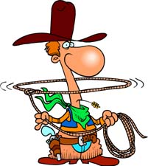
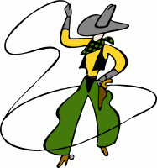
Back in the saddle again!
Lesson 1-3

Slide 2
BENEVOLENT (beh-NEV-oh-lent) adj.
Definition: kindhearted; good-natured; generous
Sounds like: Ben Elephant
Picture: A kindly old elephant named Ben who lives at the zoo. He saves the peanuts that visitors give him and takes them to the other animals late at night. “That Ben Elephant,” says one bear to another, “what a nice guy.”
Synonyms: caring, giving, kind
Antonyms: malevolent, selfish, mean
Other forms: benevolence (noun); benevolently (adv.)
Sentence: Miserable and greedy for most of his life, the man became benevolent during his last years.

Slide 3
MOLLIFY (MOLL-ih-fie) verb
Definition: lessen anger; soothe; placate
Sounds like: Molly Fly
Picture: Molly Fly follows the Village Fly (a really BAD FLY who spreads lies and rumors) around; she soothes the feelings of the people he has upset.
Synonyms: pacify, calm, relax
Antonyms: anger, aggravate, annoy
Sentence: Police try to mollify a hostage-taker to avoid violence.

Slide 4
PONDEROUS (PONN-der-uss) adj.
Definition: slow; weighty; labored
Sounds like: pond of rust
Picture: Creatures made of metal wading through a pond. As they begin to rust, their movements become slower and more difficult.
Synonyms: lethargic, heavy, bulky
Antonyms: light, feathery, quick
Other form: ponderously (adv.)
Sentence: The music was heavy and ponderous, and I fell asleep.

Slide 5
AMBIVALENCE (am-BIV-uh-lence) noun
Definition: indecision; feeling of being; pulled into two directions
Looks like: Val inside ambulance (ambiVALence)
Picture: A woman named Val is about to have a baby. She’s gone into labor while her husband is at work. She’s called for an ambulance to take her to the hospital, but now that she’s inside the ambulance she’s having second thoughts about going without her husband. “Wait! Let’s give him a few more minutes. No, we should go. I’m in labor. Okay, take me to the hospital. No, wait! Maybe he’ll get here soon …”
Other forms: ambivalent (adj.); ambivalently (adv.)
Sentence: The house had been in the family for generations, so they were ambivalent about selling it.

Slide 6
Inadvertent (in-ad-VER-tent) adj
Definition: Unintentional
Sounds like: in at her tent
Picture: An army troop camping out during an overnight hike. One of the men accidentally walks into the tent of an officer. The furious officer throws the soldier out. The soldier states, “I inadvertently entered the wrong tent, and I apologize.”
Synonyms: careless; not on purpose; unwitting
Antonyms: intentional; deliberate; planned
Other form: inadvertently (adv.); inadvertence (noun)
Sentence: The newspaper inadvertently switched the names under the picture.

Slide 7
INCITE (in-SITE) verb
Definition: arouse to action; stir up; foment
Sounds like: ignite
Picture: Long ago there was a small country that had been controlled by a foreign nation for many years. One day, on the tenth anniversary of the country’s takeover, a woman runs through the streets of the capital. She calls for action, urging citizens to fight for their freedom. Like a spark falling into dry grass, she incites a fire of anger among the people, and it quickly grows into a blazing revolution.
Other forms: incitement, incitation (nouns); Note: Don’t confuse with “insight,” the ability to perceive.
Sentence: The angry miner incited his co-workers to strike.

Slide 8
CACOPHONY noun
Definition: a collection of sounds or voices that don’t blend well; harshness of sound.
Looks like: a combination of “cocoon” and “symphony”
Picture: A cocoon hanging from the branch of a tree. Inside, a caterpillar on his way to becoming a butterfly has decided to make good use of the time by learning to play the violin. On this particular day, the caterpillar is playing an entire symphony, although not very well. Outside, the birds and squirrels are covering their ears, trying to escape the cacophony coming from the cocoon.
Synonyms: dissonance; disharmony
Antonym: harmony
Note: The root “phone” has to do with sound, as in “telephone.”
Sentence: New visitors to the rainforest are struck by the cacophony.

Slide 9
EFFERVESCENCE noun
Definition: the quality of being bubbly or full of life
Sounds like: ever pheasants
Picture: A large field surrounded by trees. The field is crowded with pheasants who are turning around singing, dancing, and blowing enormous bubbles with those gigantic plastic rings and large pans of soap suds. Two small beavers look on, one saying to the other, “Ah, pheasants, ever pheasants. So bubbly. So full of life … Well, let’s get back to work.”
Synonyms: animation; exhilaration; exuberance
Antonyms: dullness; flatness
Sentence: She’d had little acting experience, but her effervescence got her the part.

Slide 10
PARITY noun
Definition: equality or equivalence; balance among a group
Looks like: party
Picture: A boy is having a birthday party at his house. On the same day, the girl next door is having her birthday party. Holding a pair of binoculars, the boy watches everything that happens at the other party, then runs to his mother and demands equality. “Her cake is chocolate with pink frosting. That’s what I want. And a clown just showed up. Where’s my clown? She has bigger balloons …”
Synonyms: equivalence; equality; par; uniformity; similarity
Antonyms: dissimilarity; disparity
Note: Don’t confuse this word with “parody,” which refers to an imitation that is meant to poke fun at the subject.
Sentence: There is parity in a sports league when no one team dominates every year.

Slide 11
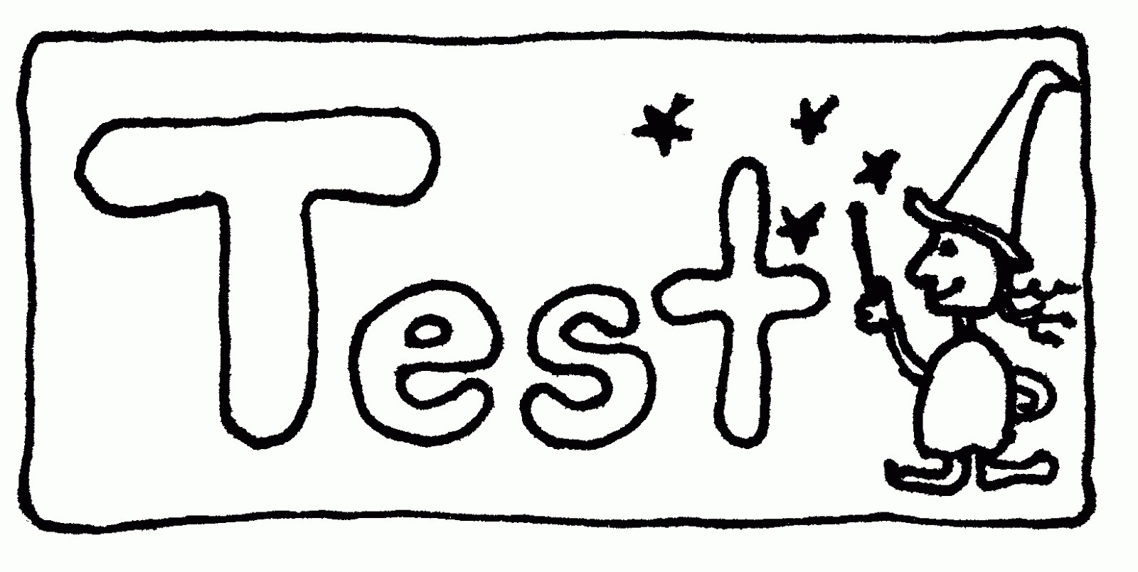
Test time
Stop right there!!

